Slide 1
BINARY TREE

Slide 2
BINARY TREE
A binary tree is a special form of tree in which a node can have atmost two children
A node in a binary tree may not necessarily have the maximum of two children i.e either 1,2 or 0 child.
A tree which does not contain any node is called empty binary node.

Slide 3
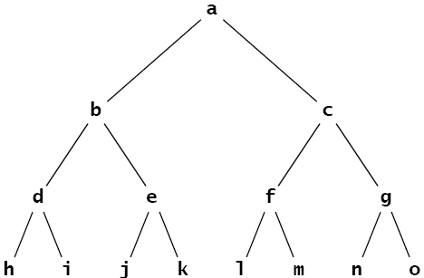
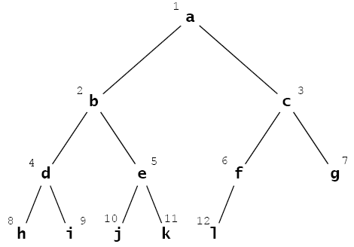
Binary Tree
Full binary tree
Complete binary tree

Slide 4
Full Binary Tree
A binary tree is said to be full binary tree if each node has exactly zero or two children.
Also known as proper binary tree

Slide 5
Complete Binary Tree
A complete binary tree is either a full binary tree or one in which every level is fully occupied except possibly for the bottomost level where all the nodes must be as far left as possible.

Slide 6
PROPERTIES OF BINARY TREE
1.The maximum number of nodes in a binary tree on a given level (say L) is 2^{L a},where L>=0 .
2.The maximum number of nodes in an binary tree with height h is 2^{h+1}-1
3.the minimum number of nodes possible in a binary tree of height h is h+1

Slide 7
4.if n is the number of nodes and e is the number of edges in an non-empty binary tree then n=e+1.
5.if n₀ is the number of leaf nodes (no child) and n₂ is the number of nodes with two children in a non-empty binary tree then n₀₌ n₂+1
6.for a complete binary tree T with n nodes ,the height is floor[log₂(n+1) -1]

Slide 8
Binary Tree Traversal Techniques
Three recursive techniques for binary tree traversal
In each technique, the left subtree is traversed recursively, the right subtree is traversed recursively, and the root is visited
What distinguishes the techniques from one another is the order of those 3 tasks

Slide 9
Preoder, Inorder, Postorder
In Preorder, the root
is visited before (pre)
the subtrees traversals
In Inorder, the root is
visited in-between left
and right subtree traversal
In Preorder, the root
is visited after (pre)
the subtrees traversals
Preorder Traversal:
Visit the root
Traverse left subtree
Traverse right subtree
Inorder Traversal:
Traverse left subtree
Visit the root
Traverse right subtree
Postorder Traversal:
Traverse left subtree
Traverse right subtree
Visit the root

Slide 10
Illustrations for Traversals
Assume: visiting a node
is printing its label
Preorder:
1 3 5 4 6 7 8 9 10 11 12
Inorder:
4 5 6 3 1 8 7 9 11 10 12
Postorder:
4 6 5 3 8 11 12 10 8 9 7 1
1
3
7
5
8
9
10
4
6
11
12

Slide 11
Illustrations for Traversals (Contd.)
Assume: visiting a node
is printing its data
Preorder: 15 8 2 6 3 7
11 10 12 14 20 27 22 30
Inorder: 3 6 7 2 8 10 11
12 14 15 20 22 27 30
Postorder: 3 7 6 2 10 14
12 11 8 22 30 27 20 15
15
8
20
2
11
27
6
10
12
22
30
3
7
14

Slide 12
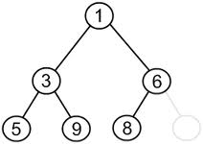
Tree Traversals
Pre-Order(NLR)
1, 3, 5, 9, 6, 8

Slide 13
Tree Traversals
In-Order(LNR)
5, 3, 9, 1, 8, 6

Slide 14
Tree Traversals
Post-Order(LRN)
5, 9, 3, 8, 6, 1

Slide 15
PRE-ORDER USING STACK
PREORD(INFO,LEFT,RIGHT,ROOT): A binary tree T is in memory .The algorithm does a preorder traversal of T, applying an operation PROCESS to each of its node. An array STACK is used to temporarily hold the addresses of nodes.

Slide 16
1.[Initiaaly push NULL onto STACK and initialize PTR]
Set TOP←1.STACK[1]←NULL and PTR←ROOT
2.Repeat steps 3 to 5 while PTR!=NULL
3.Apply PROCESS to INFO[PTR]
4.[Right Child?]
If RIGHT[PTR]!=NULL [Push on STACK]
TOP←TOP+1
STACK[TOP]←RIGHT[PTR]
[End of if structure]

Slide 17
5.[Left Child ?]
If LEFT[PTR]!=NULL,
Set PTR←LEFT[PTR]
Else [pop from stack]
PTR←STACK[TOP]
TOP←TOP-1
[End of if strucutre]
[End of step 2 loop]
6.Exit

Slide 18
IN-ORDER
INORDER(INFO,LEFT,RIGHT,ROOT):A binary tree is in memory. This algorithm does an inorder traversal .applying PROCESS to each of its node.An array STACK is used to temporarily hold the addresses of node.

Slide 19
1.[Push NULL onto STACK and initialize PTR]
TOP←1,STACK[1]←NULL and PTR←ROOT
2.Repeat while PTR!=NULL [Push left most path onto stack]
a)TOP←TOP+1 and STACK[TOP]←PTR [Saves nodes]
b)PTR←LEFT[PTR] [updates PTR]
[End of loop]
3.PTR←STACK[TOP]
TOP←TOP-1 [pops node from STACK]

Slide 20
4.Repeat steps 5 to 7 while PTR!=NULL [Backtracking]
5.Apply PROCESS to INFO[PTR]
6.[Right child?]
If RIGHT[PTR]!=NULL
a)PTR←RIGHT[PTR]
b)GOTO step 2
7.PTR←STACK[TOP]
TOP=TOP-1 [Pops node]
[end of step 4 loop]
8.Exit

Slide 21
POSTORDER
POSTORD(INFO,LEFT,RIGHT,ROOT):A binary tree T is in memory.This algorithm does a postorder traversal of T,applying an operation PROCESS to each of its node.An array STACK is used to temporarily hold the address of nodes

Slide 22
1.[push NULL onto STACK and initialize PTR]
Set TOP←1,STACK[1]←NULL,PTR←ROOT
2.[Push left-most path onto STACK]
Repeat steps 3 to 5 while(PTR!=NULL)
3.TOP←TOP+1
STACK[TOP]←PTR [ Pushes PTR on STACK]
4.if RIGHT[PTR]!=NULL, then [Push on STACK]
TOP←TOP+1 and STACK[TOP]=-RIGHT[PTR].
[end of If strucutre]

Slide 23
Set PTR←LEFT[PTR] [Updates pointer PTR]
[End of Step 2 loop]
6.Set PTR←STACK[TOP] and TOP←TOP-1 [Pops node from STACK]
7.Repeat while PTR>0.
A)Apply PROCESS to INFO[PTR]
B)Set PTR←STACK[TOP] and TOP←TOP-1 [pops node from STACK]
8.If PTR<0 ,then:
a)PTR←-PTR
  b)Goto step 2.
  [End of If structure]
  9.EXIT

Slide 24
Preorder Traversal
N-L-R
H
D
L
B
F
J
N
A
C
E
G
I
K
M
O
H | D | B | A | C | F | E | G | L | J | I | K | N | M | O

Slide 25
Inorder Traversal
L-N-R
H
D
L
B
F
J
N
A
C
E
G
I
K
M
O
A | B | C | D | E | F | G | H | I | J | K | L | M | N | O

Slide 26
Postorder Traversal
L-R-N
H
D
L
B
F
J
N
A
C
E
G
I
K
M
O
A | C | B | E | G | F | D | I | K | J | M | O | N | L | H

Slide 27
PRACTICE QUESTIONS

Slide 28
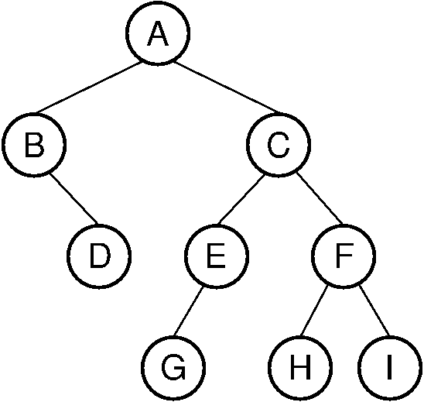
PRACTICE

Slide 29
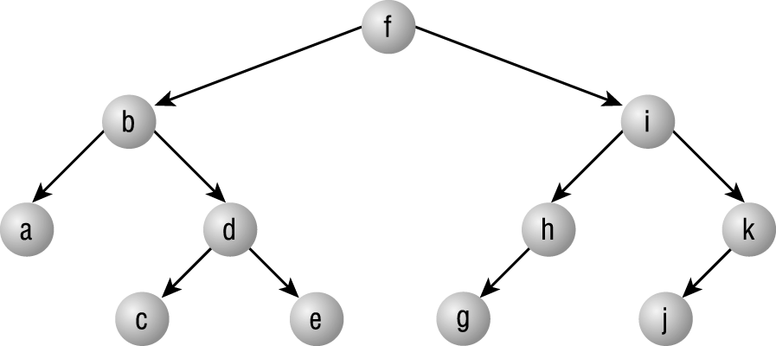

Slide 30
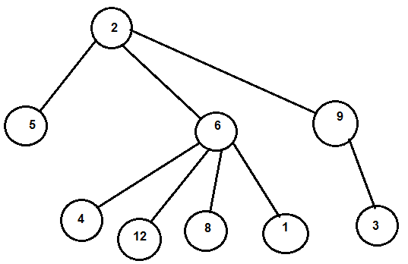

Slide 31
